Slide 1

Laundry Management system.
Adamu, Mohammed (From Ghana ) Gujarat Technological University- Ahmedabad India

Slide 2
Introduction
As the world keeps changing and busy schedules of people is on the increase.
Laundry service has come to stay.
It is now an enterprise on it own.
Laundry service has taken away the difficult task of washing your cloths even when you not feeling well.

Slide 3
System Description
Features:
Manage the records of both human and logistics.
Provide a way of knowing your customers.
Schedule your laundry pickups.
Scope:
Secure web application to protect customer data.

Slide 4
System Description
Objectives:
To manage and maintain various laundry activities.

Slide 5
Tools (Hardware & Software Requirements)
Minimum Hardware Requirements for Development
Processor: Intel dual core, AMD and above, 1.00GHz
RAM: 2GB and above
Hard disk: 120GB and above
Minimum Hardware Requirements for Implementation and Usage
Any hosting package being dedicated or shared hosting.
SSL certificate: (Domain Validation Certificate or Extended Validation Certificate)
Any computer or mobile phone capable browsing the web
Software Requirement for Development
Development platform: Laravel framework, PHP, XAMPP, MySQL
Framework: Bootstrap
IDE/Editors: Sublime text and Notepad ++

Slide 6
Bibliography
Books:
PHP Manual
PHP and My SQL Web Development
FUNDAMENTALS OF Database Systems SEVENTH EDITION
Websites:
https://laravel.com/docs/5.8/
www.w3schools.com
www.jquery.com
www.stackoverflow.com
https://fontawesome.com/
http://getbootstrap.com/

Slide 7
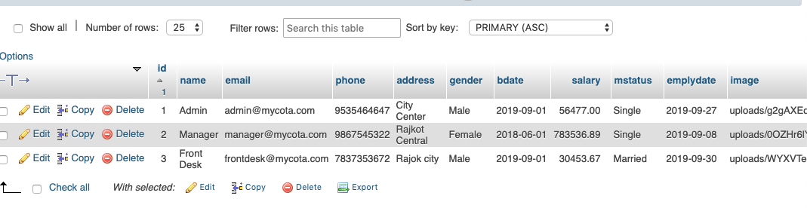
Screen shots

Slide 8
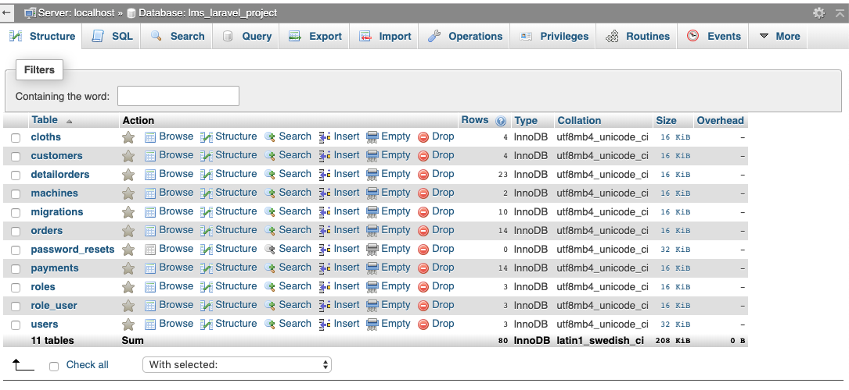
Screen shots

Slide 9
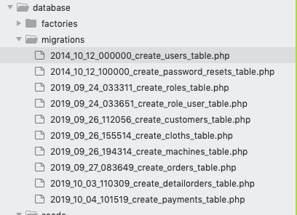
Screen shots

Slide 10
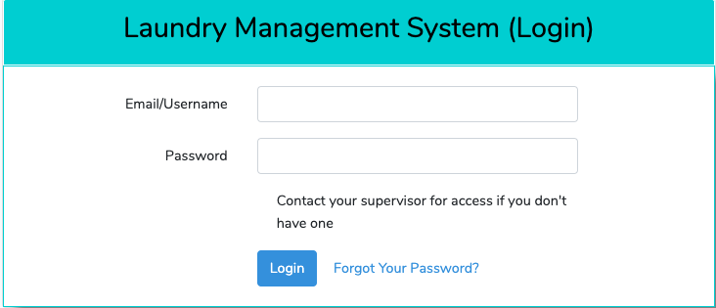
Screen shots

Slide 11
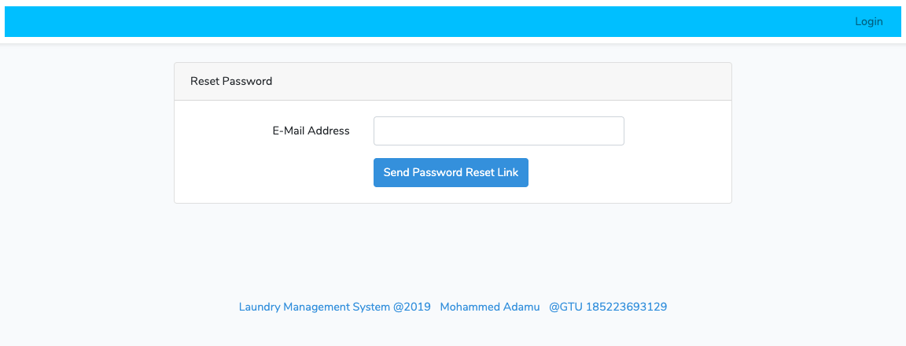
Screen shots

Slide 12
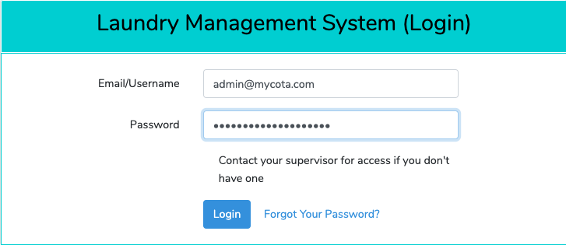
Screen shots

Slide 13
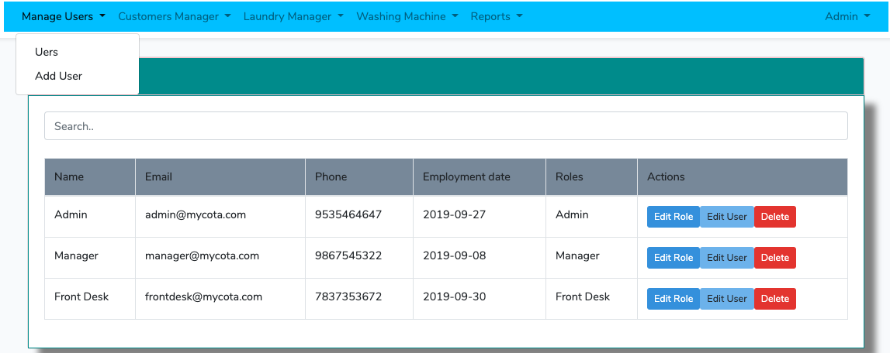
Screen shots

Slide 14
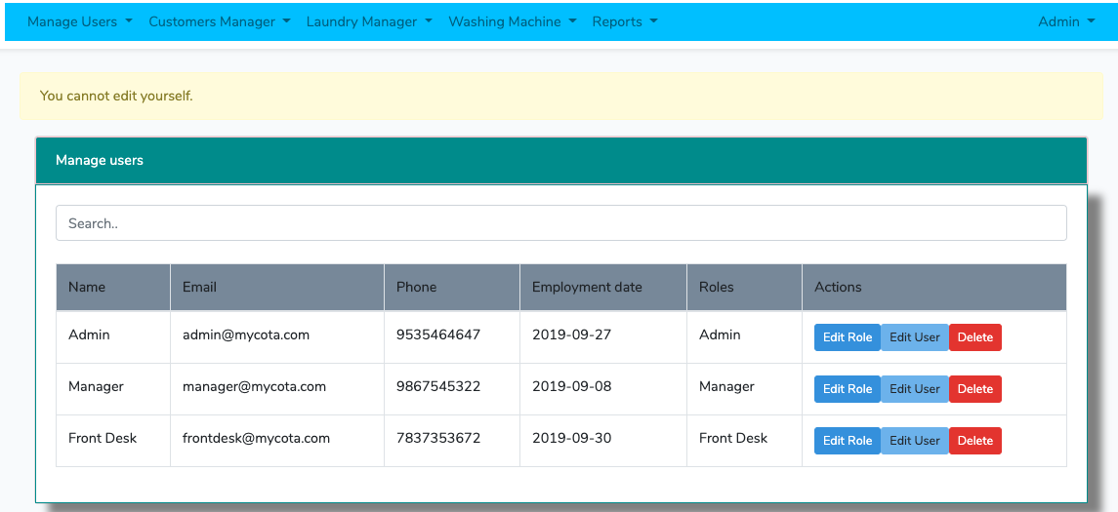
Screen shots

Slide 15
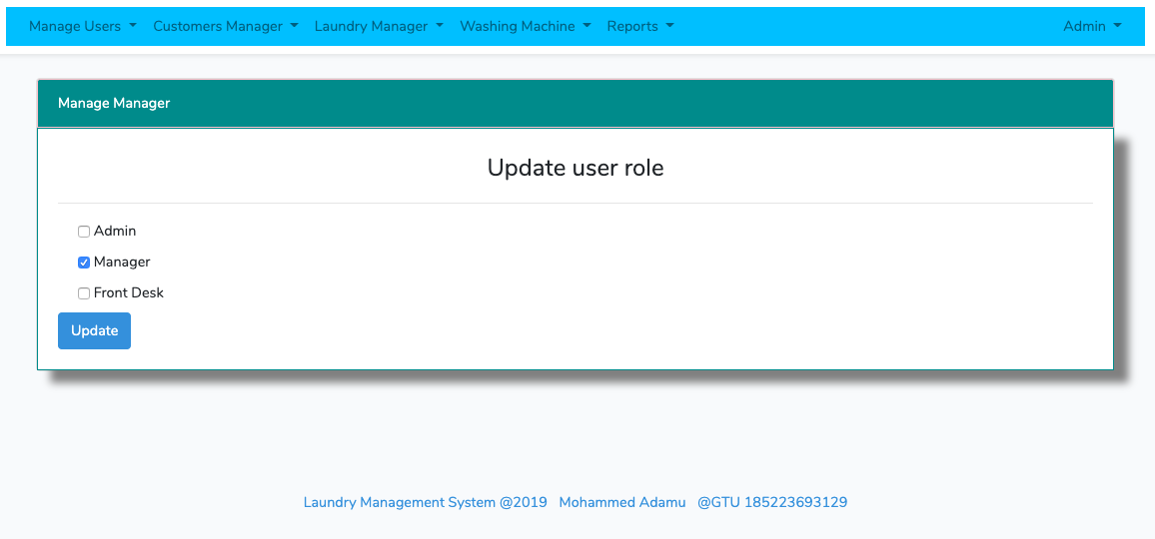
Screen shots

Slide 16
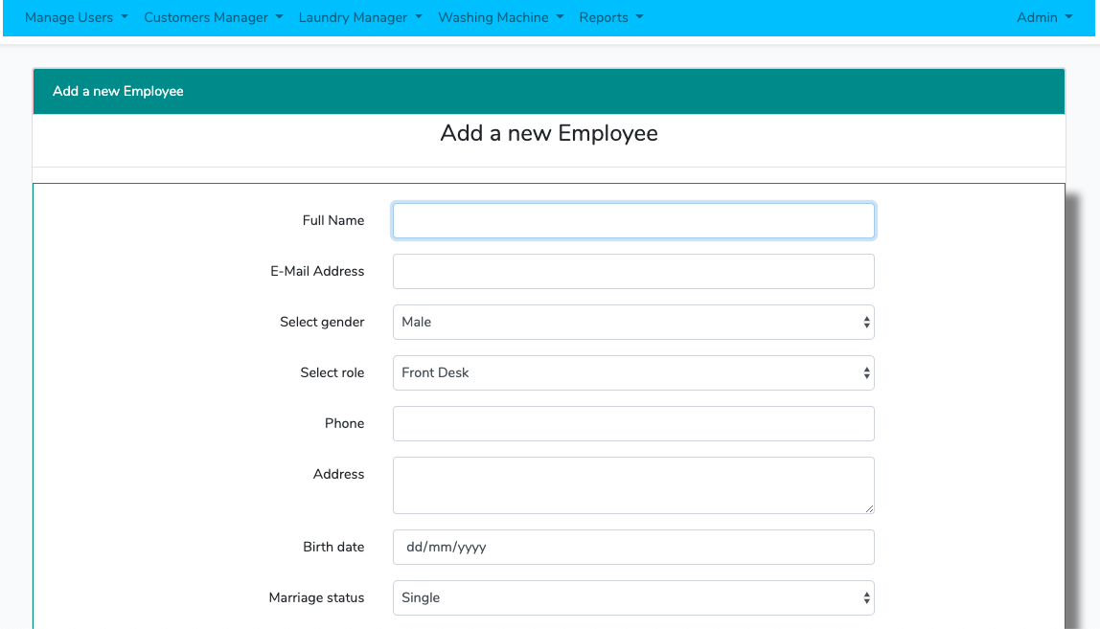
Screen shots

Slide 17
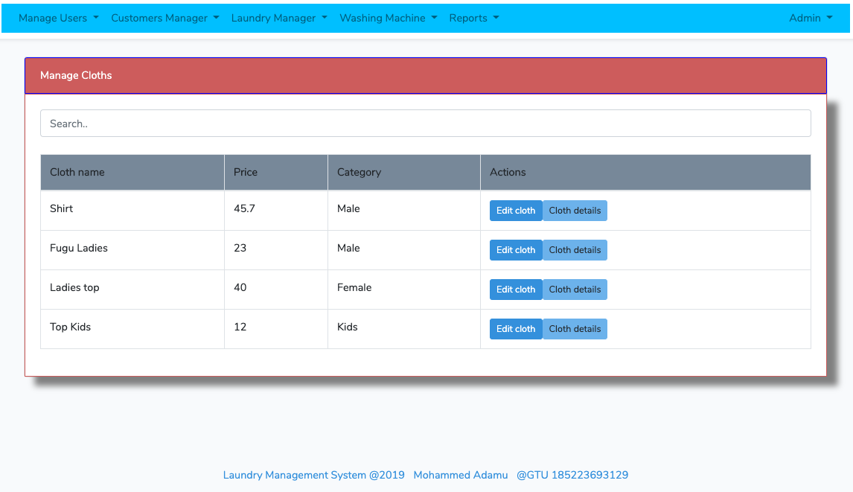
Screen shots

Slide 18
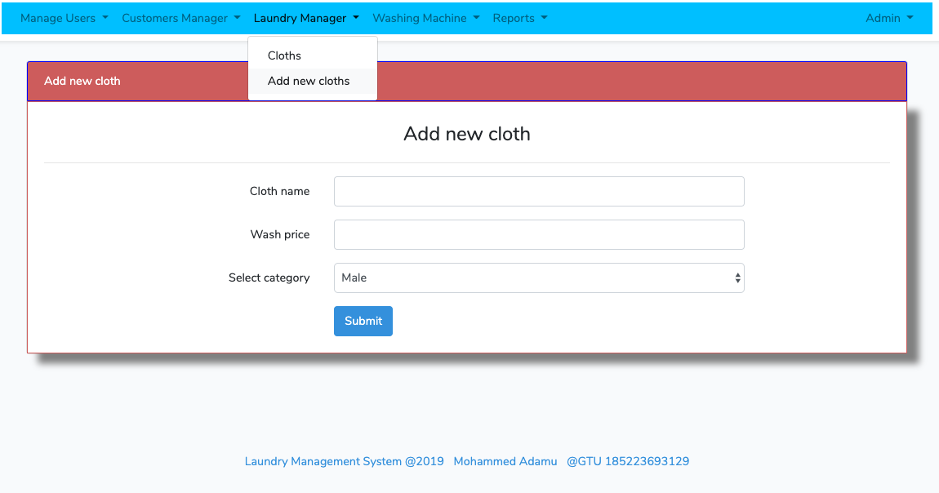
Screen shots

Slide 19
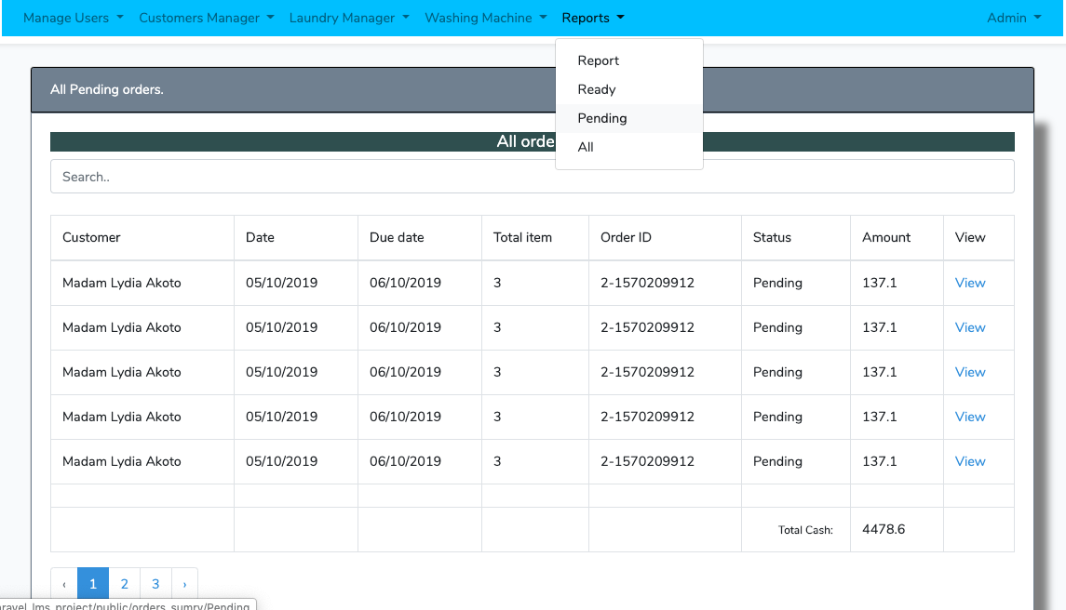
Screen shots

Slide 20
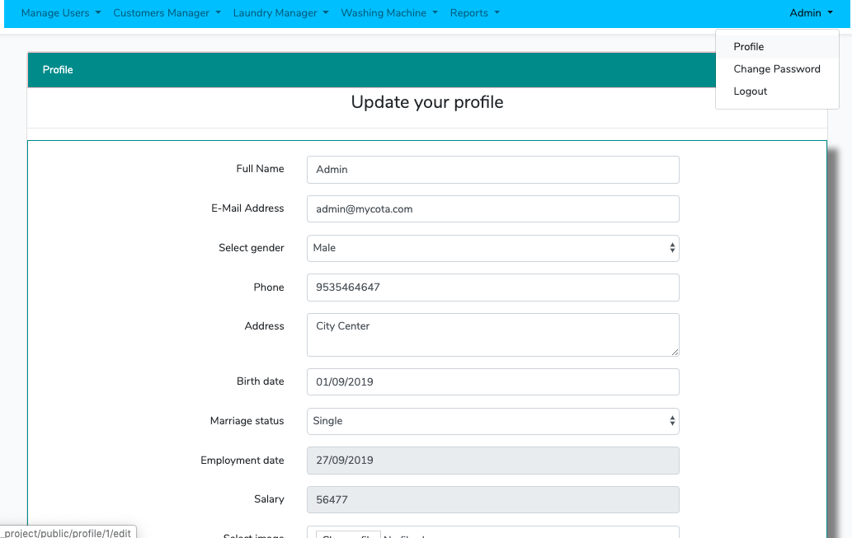
Screen shots

Slide 21
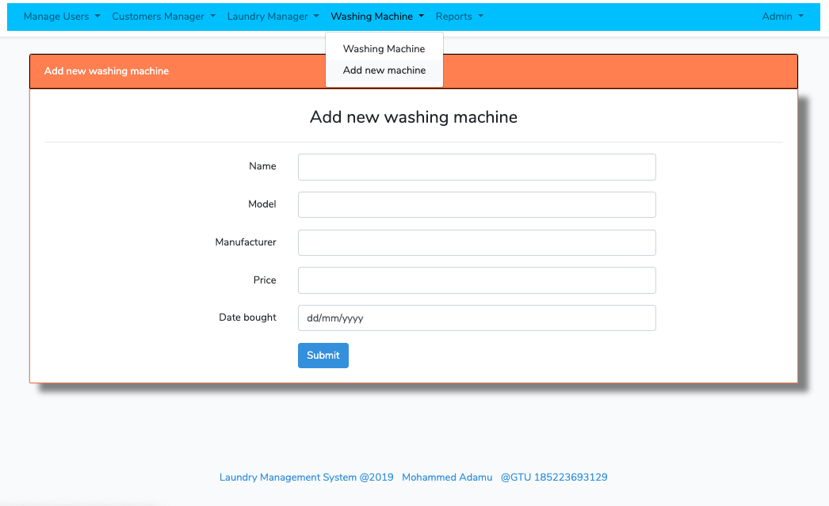
Screen shots

Slide 22
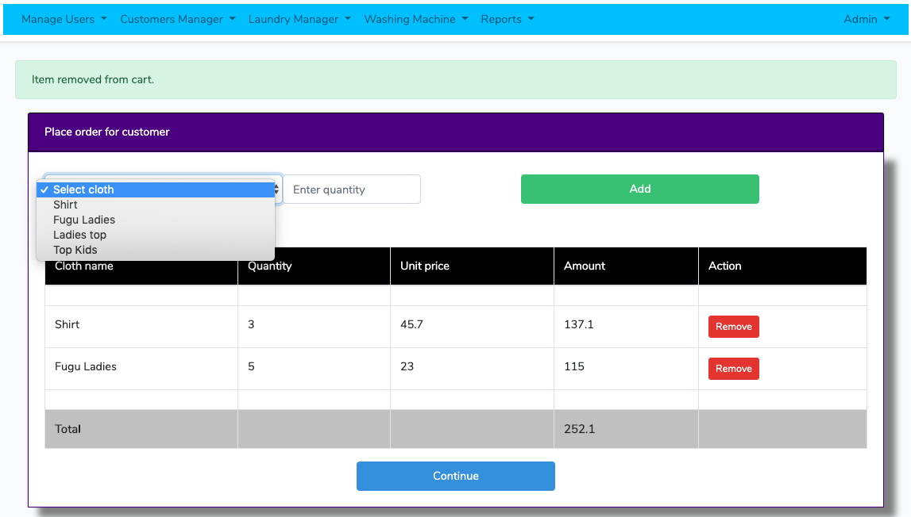
Screen shots

Slide 23
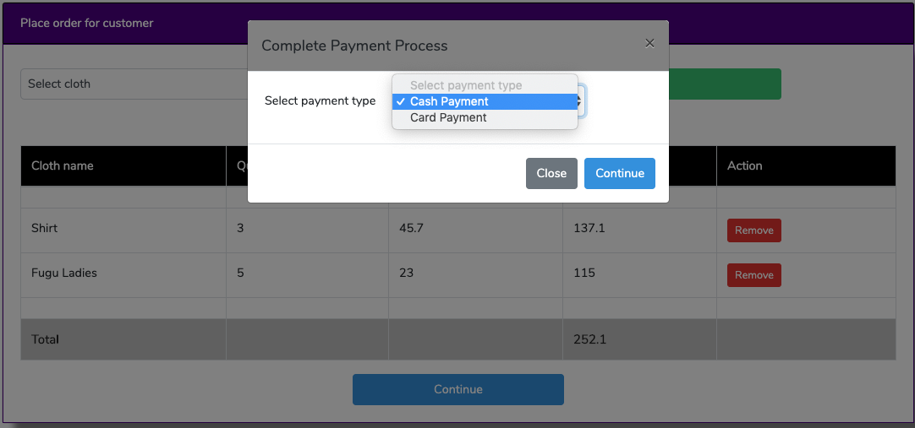
Screen shots

Slide 24
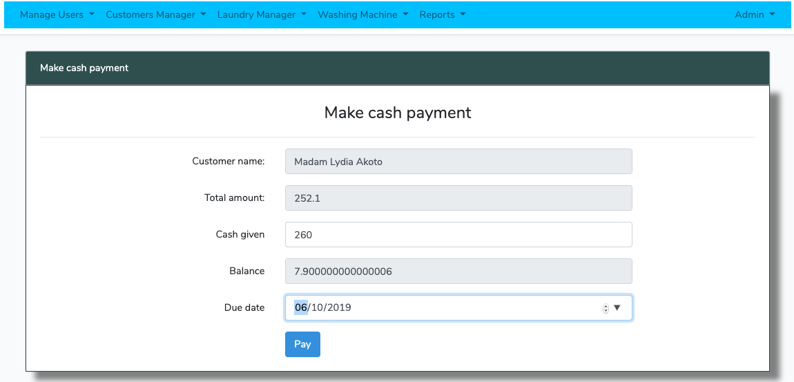
Screen shots

Slide 25
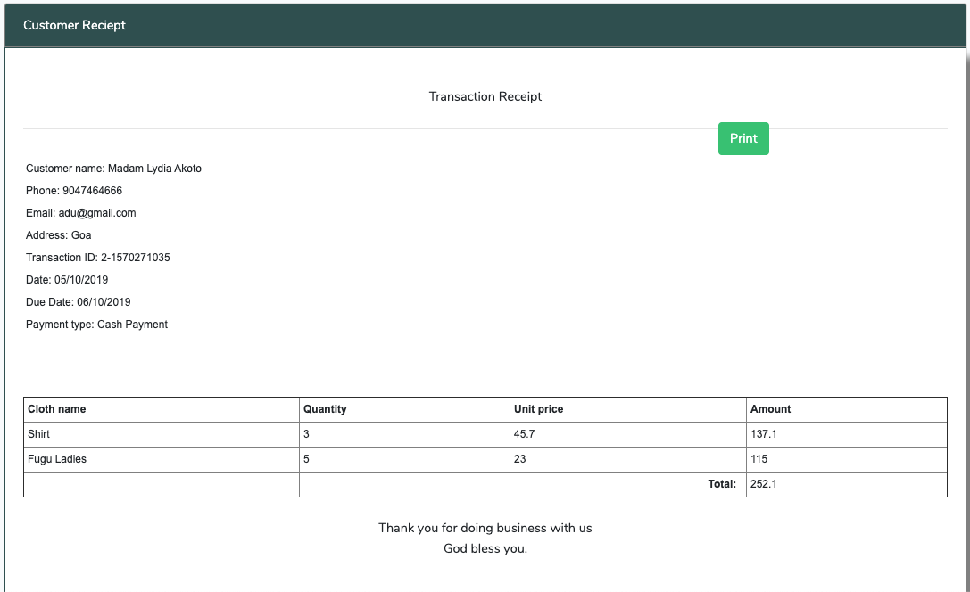
Screen shots

Slide 26
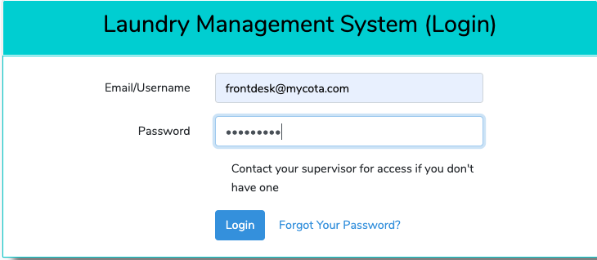
Screen shots

Slide 27
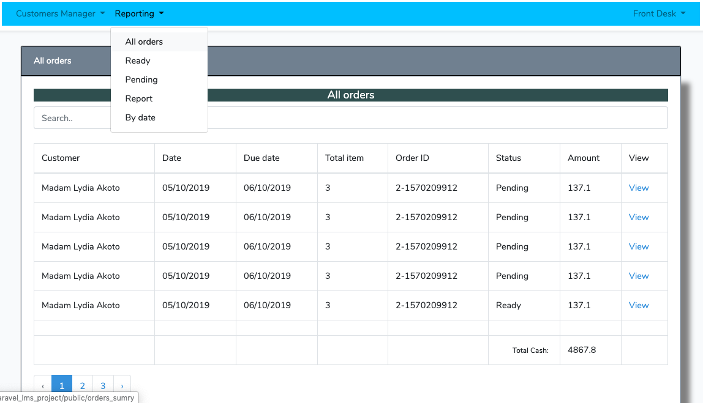
Screen shots

Slide 28
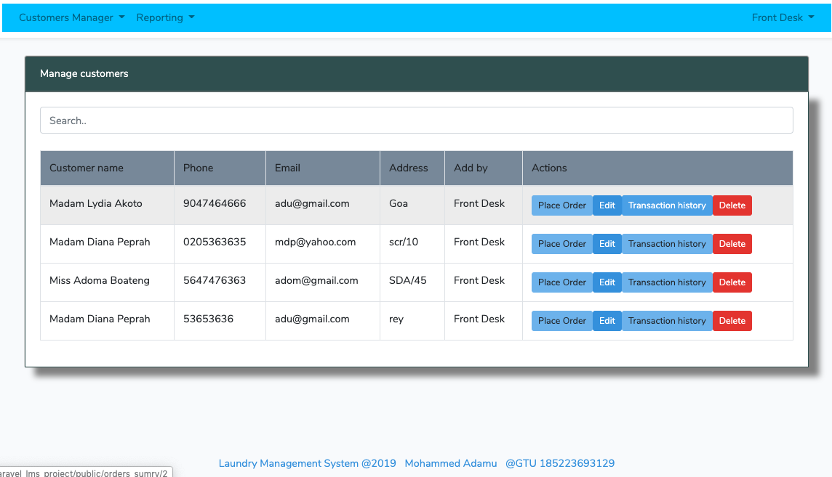
Screen shots

Slide 29
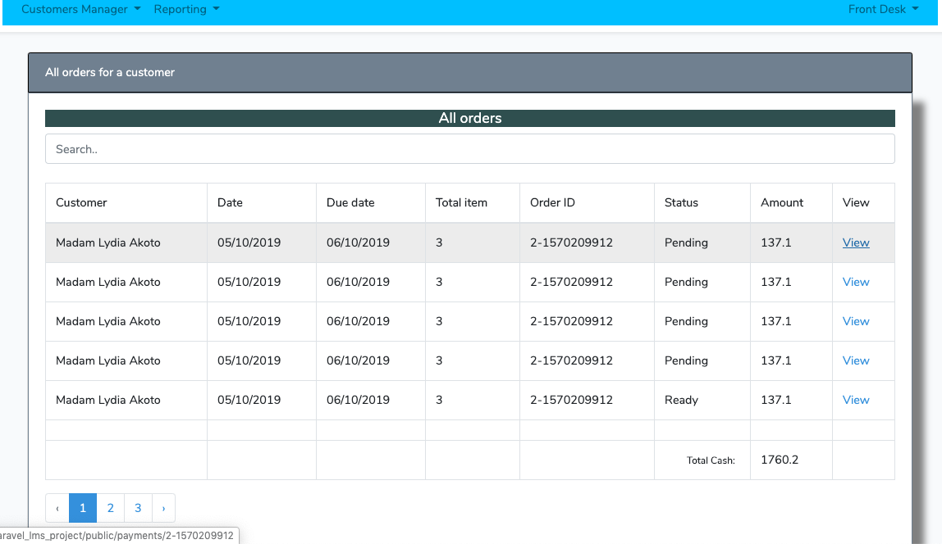
Screen shots

Slide 30
Conclusion
Although there are certain limitations of this system, but when worked on it has the potential for real world implementations.
You can get the source code from https://github.com/mycota/Laravel-laundry_MS

Slide 31
THANK YOU

